Slide 1
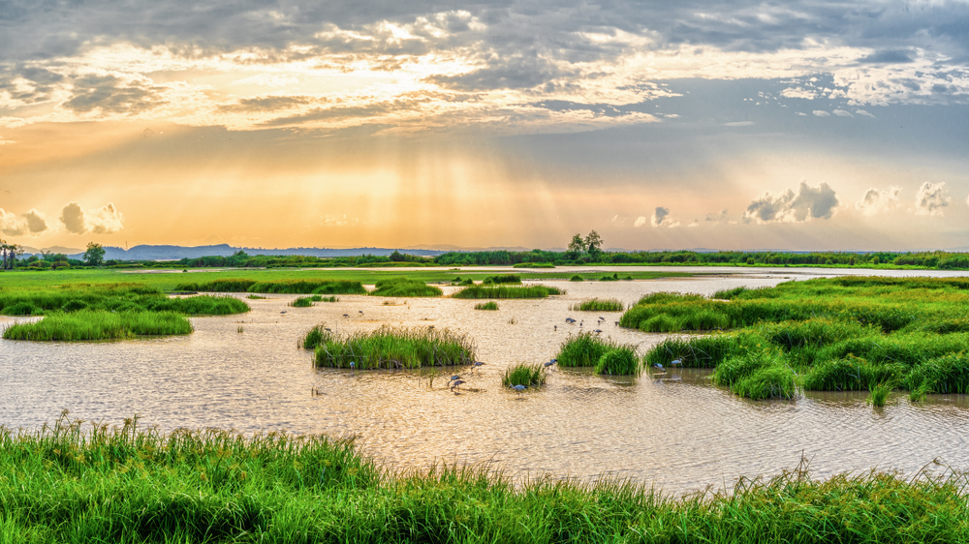
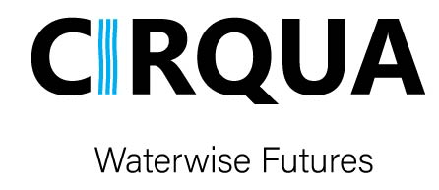

Slide 2
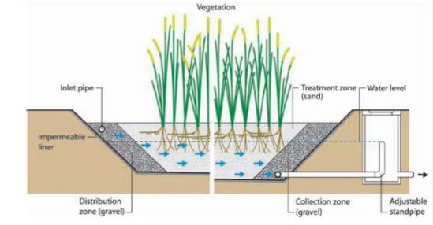
Title:
Integrated Approaches at Local Scale for Enhancing Water Reuse Efficiency and Sustainable Soil Fertilization from Wastewater’s Recovered Nutrients
CIRQUA aims to improve nature-based solutions (NBS), focusing on constructed wetlands (CWs) for wastewater treatment and water recovery in rural areas.
CIRQUA will upgrade CWs using technological achievements, such as innovative nanostructured filters and photocatalytic modules, cultivation of N2-fixing legumes, sensors and automation in operation, precision irrigation principles and integration of advanced artificial intelligence (AI) tools. These innovations will aid improve effluent quality, allowing the treated water and CW biomass to be used for irrigation and fertilization purposes, thus promoting circular economy at local scale.

Slide 3
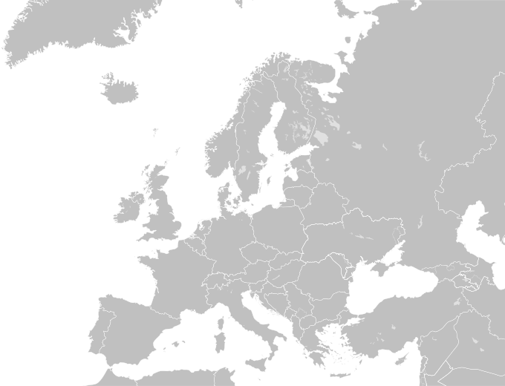
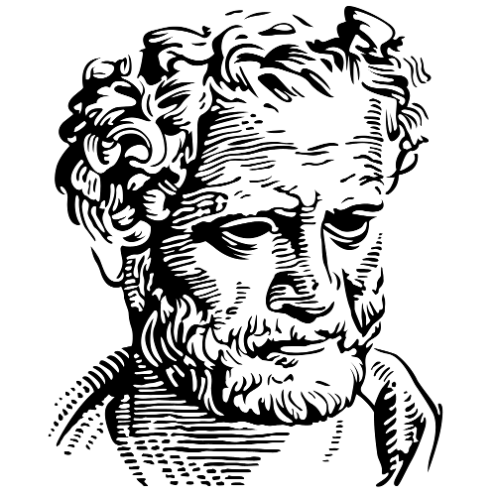


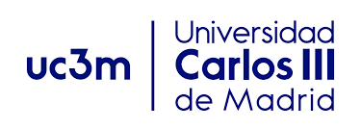









DUTH
M3R
UC3M
UAET
Democritus University of Thrace
Monitoring and Management of Microbial Resources
Universidad Carlos III de Madrid
University Abdelmalek Essaâdi-Tetouan
ASU
UMA
IU
uDev
CIIM
Ain Shams University
University of Manouba
Istanbul University
uDevelop e.V.
Interdisciplinary Center for Marine and Environmental Research
UCY
UPAT
ABC
UBas
University of Cyprus
University of Patras
African Biotechnology Company
University of Basilicata
Notes:
African Biotechnology Company

Slide 4
WP1
WP3
WP5
WP7
Synthesis of innovative nanomaterials and photocatalysts for water reclamation and soil fertilization purposes
Evaluation of biomass-derived nanomaterials and treated effluent as soil fertilizers
Environmental and socioeconomic assessment of CIRQUA technologies for water reclamation and soil fertilization
Project Managemen and Coordination
WP2
WP4
WP6
Design, construction and testing of innovative CW prototypes for enhanced wastewater reuse
Technology upscaling, optimization and validation
Communication, Dissemination and Exploitation

Slide 5
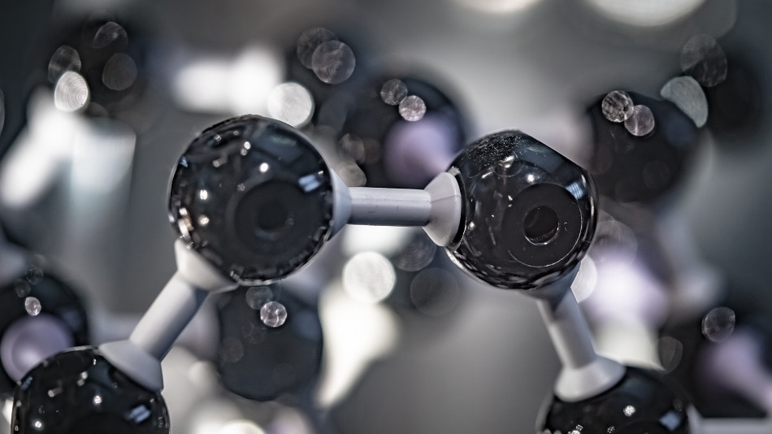
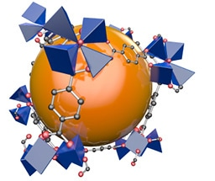
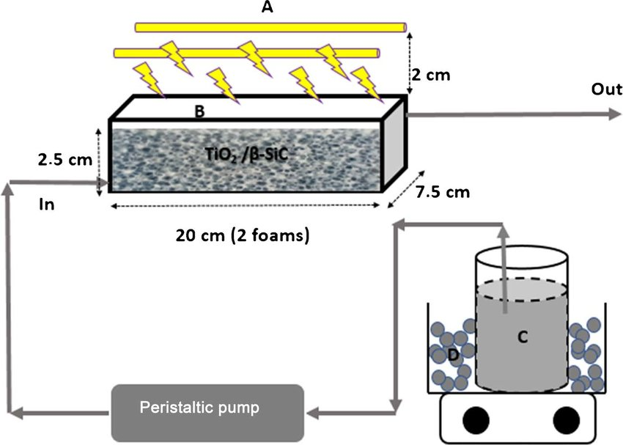
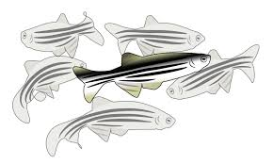
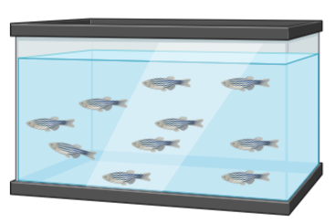
WP1 focus on the preparation of MOFCs nanomaterials, acting as filters for wastewater treatment in CWs, and of the photocatalysts for water reclamation.
Toxicity assessment of MOFs and MOFCs suspension will be evaluated against the fish Danio rerio (zebrafish), following the OECD test guidelines. Also, Toxicity assessment issues regarding the photocatalytic process will be examined using zebrafish.
WP1
Control
1 μg/mL
3 μg/mL
5 μg/mL

Slide 6
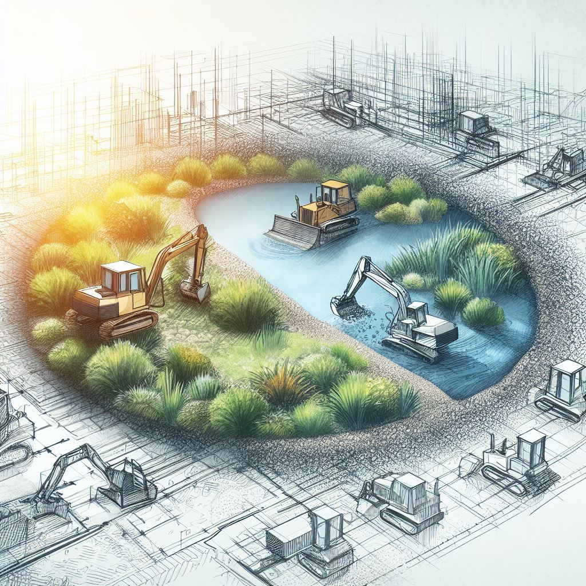
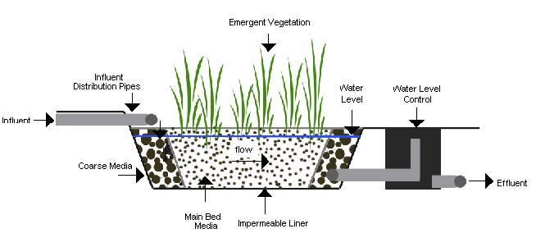
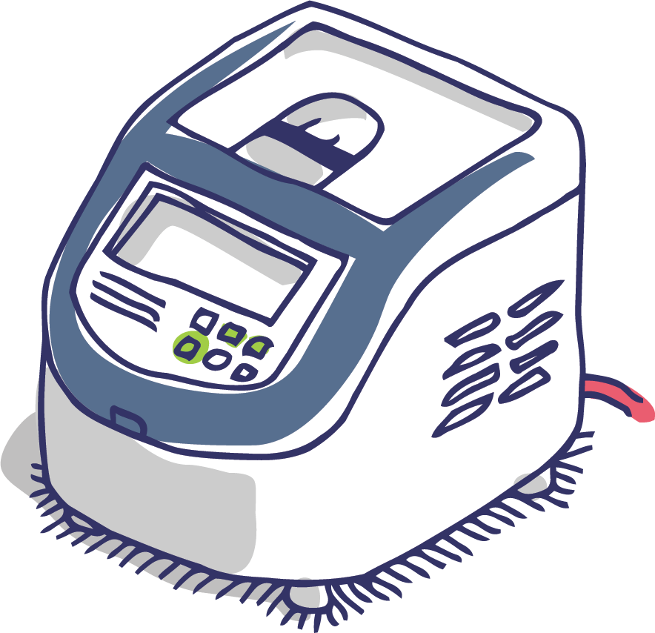
WP2
WP2 will construct experimental prototypes of CWs to test the performance of these nanomaterials and the application of photocatalysis in the removal of pollutants from wastewater.
Task 2.4. SARS-CoV-2 surveillance and assessment of pathogens and residual DNA removal efficiency
Ecotoxicity test
SARS-CoV-2 quantification
Effluent
Residual DNA measurements
Enumeration of effluent bioindicators
Notes:
residual DNA measurements

Slide 7
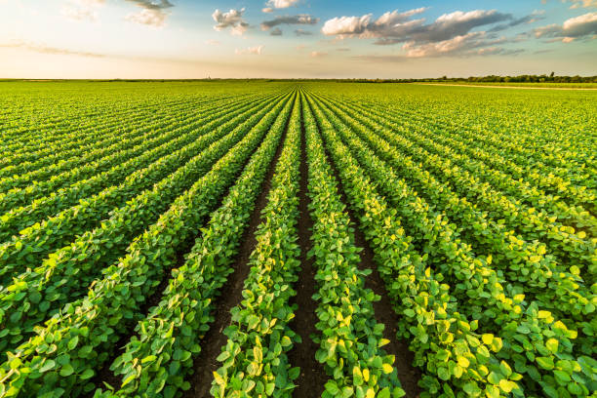
WP3
WP3 will reuse the enriched in nutrients and carbon nanomaterials as fertilizers in selected crop fields.
At WP4, will demonstration sites of diverse soil, climate and crops will be developed, and in parallel, implementation of advanced precision irrigation and fertilization technologies will be employed to save water and energy.
WP4

Slide 8
WP5
WP5 will engage stakeholders and assess the socio-economic and environmental impacts of applied technologies, identify risks and opportunities related to the potential use of the Project Results, and provide policy recommendations.
WP6, Communication, Dissemination and Exploitation activities will facilitate the effective implementation of NBS in multiple locations. In addition, it will be responsible to connect stakeholders and partners to ensure that the business model is aligned with their needs and priorities, and that the network and its services are designed to meet the needs of users and customers and to develop a business plan outlining how they will be maintained and supported over time.
WP6

Slide 9
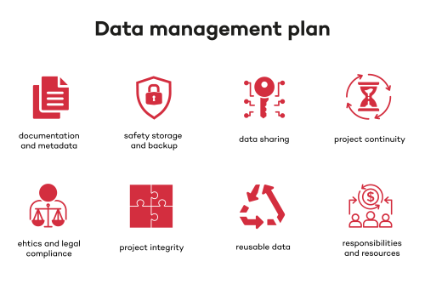
WP6
Task 6.1. Data Management Plan (DMP)
A DMP will be established to support the data management life cycle for all data that will be collected, processed or generated by the project.
Data handling
Cooperation
The DMP will define how research data will be handled not only during the lifetime of the project, but also and after it is completed
Will be jointly developed by the Coordinator and WP leaders involved in research and innovation activities.
DMP
Is a dynamic document in which all partners will be actively involved
Continuous updating according to possible needs, evolving expectations and conditions environment
Participation
Updating

Slide 10


stakeholder consultation workshops
INTIAL
SCW
Mid-project SCW
Final
SCW
Subtask 6.2.3. Stakeholder advisory board periodic consultation workshops
This part of the project involves holding meetings with stakeholders to get their input and feedback
Aimed at gathering information on the current application of NBS
Aimed at gathering information on the economic instruments and policies for promoting NBS for wastewater treatment and water reclamation
Aimed at performing a final validation of the proposed strategies, and policies in the field of NBS and water management

Slide 11

Task 6.3. Capacity building and Training activities
The goal is to increase knowledge and acceptance of CIRQUA technologies among stakeholders.
Two (2) capacity building workshops (CBWs) on the project technologies
Three train-the-trainer 2-day course on CIRQUA technologies
Promotion of CIRQUA technologies
Interviews and meetings with scientists
Two (2) on-field trainings
Notes:
(people involved or interested in the project) Interviews and meetings with scientists, environmental protection authorities and institutions, to connect them with the knowledge generation process of the project. Two (2) on-field trainings (addressed to scientists, managers and PhD students

Slide 12
Task 6.4. Stakeholder advisory board periodic consultation workshops
Dissemination and communication activities to a wider audience
Subtask 6.4.1. Visual identity & promotional materials
Visual identity: a professional designer will be contracted to develop the project identity that will be applied to the website and communication material.
Create promotional materials: Design leaflets, posters, and other materials to inform stakeholders about the project.
Subtask 6.4.2 Online engagement with stakeholders and the public
Project website: Create and maintain a platform for information sharing and communication.
Newsletter: Publish regular updates on project progress.
Social media: Utilize platforms like Twitter, LinkedIn, and Facebook to reach a wider audience.
Web portals: Disseminate project results to specific target groups through relevant online platforms.
Subtask 6.4.3. Media activity and technical dissemination
Press releases: Share project news and achievements with media.
Articles: Publish articles in relevant newsletters and journals.
Scientific publications: Produce research papers for academic community.
Conferences: Present project findings at conferences and events.
Summer school: Offer training on CIRQUA technologies.
Final conference: Showcase project results to a wide audience.
Technical booklet: Create a comprehensive guide on CIRQUA technologies.
Videos: Produce promotional videos to explain the project.
Notes:
6.4.2We aim to reach a wide audience and engage with stakeholders through digital platforms.
Build a strong online presence to share project information and updates.
Utilize social media to connect with diverse audiences.
Create interactive platforms for questions, discussions, and feedback.

